Slide 1

Analyzing the Impact of Car Features on Price and Profitability

Slide 2
Project details
The automotive industry has been rapidly evolving over the past few decades, with a growing focus on fuel efficiency, environmental sustainability, and technological innovation. With increasing competition among manufacturers and a changing consumer landscape, it has become more important than ever to understand the factors that drive consumer demand for cars. In recent years, there has been a growing trend towards electric and hybrid vehicles and increased interest in alternative fuel sources such as hydrogen and natural gas. At the same time, traditional gasoline-powered cars remain dominant in the market, with varying fuel types and grades available to consumers.
Tools used: excel and tableau

Slide 3
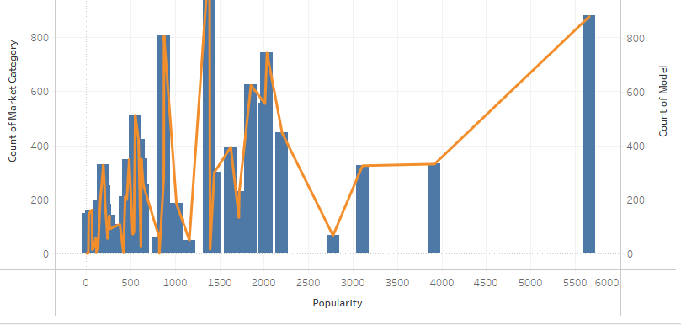
Insight 1

Slide 4
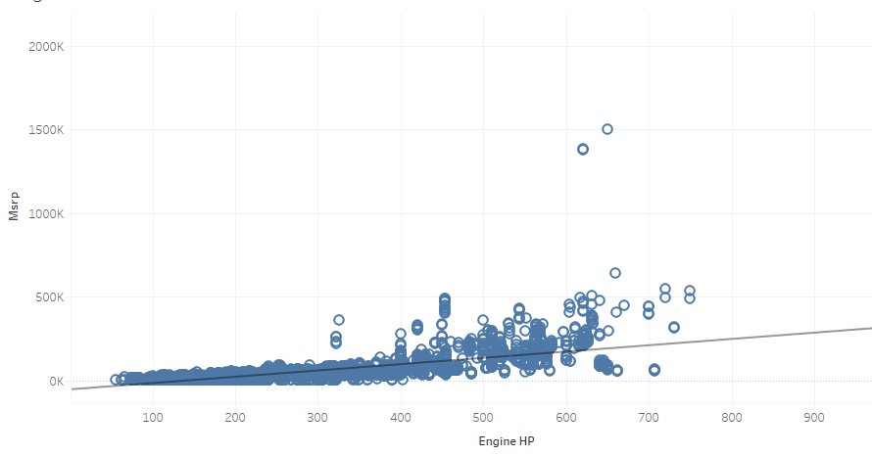
Insight 2

Slide 5
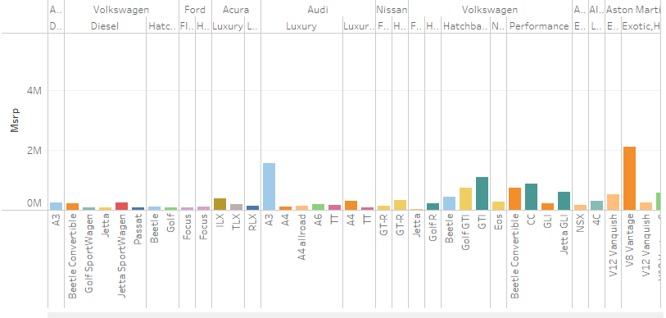
Insight 3

Slide 6
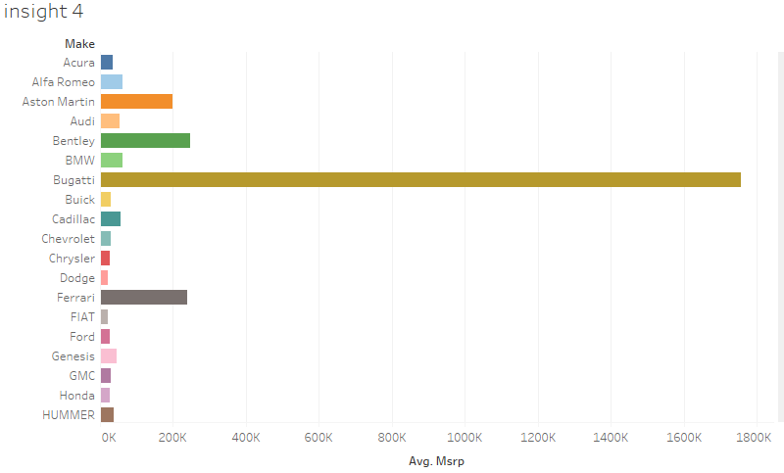

Slide 7
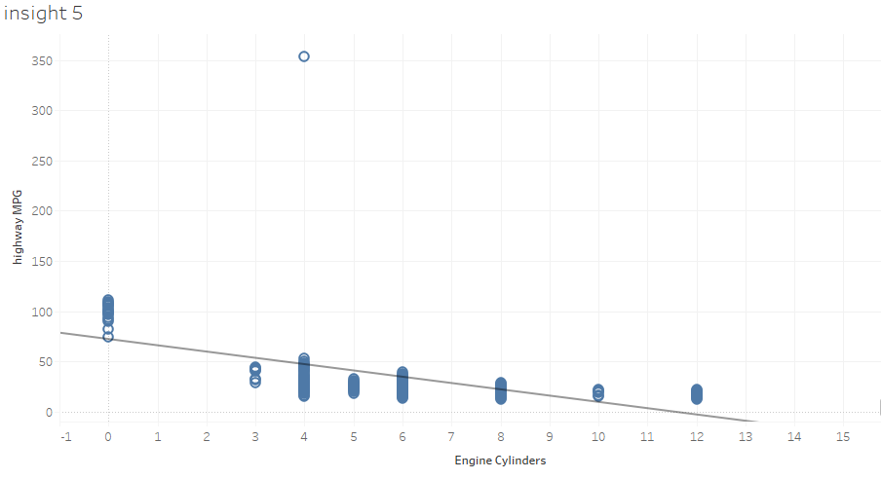

Slide 8
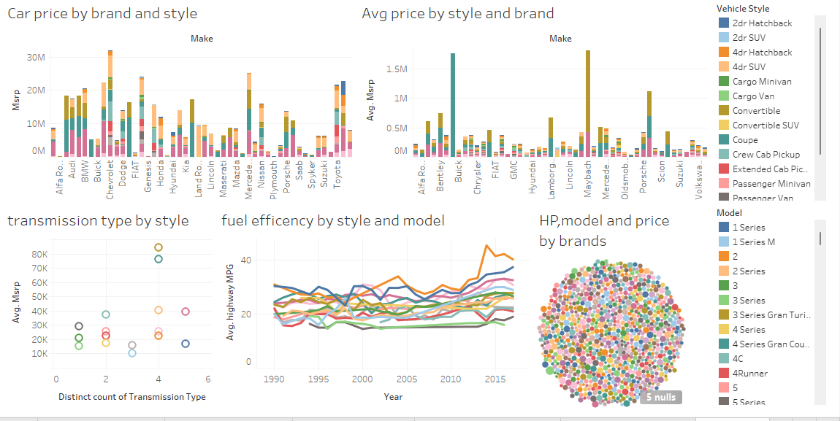

Slide 9

Hyperlinks
Excel:https://docs.google.com/spreadsheets/d/1gYGdZV4H_YgdPzLhWSPflpfLcjrU8o2P/edit?usp=sharing&ouid=109330305611183196317&rtpof=true&sd=true
Tableau:https://public.tableau.com/views/carsanalysis_16960902155820/Dashboard1?:language=en-US&:display_count=n&:origin=viz_share_link

